Slide 1

Title: FUNDAMENTAL KNOWLEDGE QUIZ BUILDER SYSTEM
Student Name: Bathula Neha
Student ID: 2520090013
Cluster:2
Section: 8
Under the Guidance
of
Supervisor Name: Jayaram Boga
Assistant Professor
Department of CSE

Slide 2

Abstract
Web-based quiz creation platform
Allows teachers to create MCQ quizzes easily
Built using HTML, CSS, and JavaScript
Supports automatic evaluation and score calculation
Provides instant feedback and result reports
Simple and user‑friendly interface for learners

Slide 3
Existing System
Traditional quizzes conducted manually
Paper‑based exams require more time
Manual evaluation may cause errors
Difficult to manage large number of questions
Limited instant feedback for students

Slide 4
Proposed System
Online quiz builder system
Teachers can create and manage quizzes
MCQ based question support
Automatic evaluation after submission
Instant score and feedback display
Generates result report for users

Slide 5
System Architecture
•User Interface (HTML, CSS)
Application Logic (JavaScript)
Question Database (JSON/Local Storage)
Quiz Engine for evaluation
Result and feedback module

Slide 6
Project Modules
User Registration & Login
Quiz Creation Module
Question Management
MCQ Support System
Quiz Attempt Interface
Automatic Evaluation
Result Report Generation

Slide 7
Objectives
Develop an interactive quiz system
Simplify quiz creation process
Provide automatic score calculation
Improve learning with instant feedback
Provide user‑friendly web interface

Slide 8
Co’s Attainments - FWD
 | 1. Co1 Internet Fundamentals, HTML & Introductory CSS Styling
 | 2. Co2 HTML Forms, Semantic Tags & Comprehensive CSS Layouts
 | 3. Co3 JavaScript Programming Essentials
 | 4. Co4 JavaScript Interactivity, DOM & Events, Storage & Async Programming
 | 5. Co 5 Advanced Web Development & Deployment (Exception handling, ES6, Forms & API Integration, CORS, SEO)

Slide 9
Co’s Attainments - DSA
Co1 Understand the concepts of web-based application development and the architecture of an online quiz system
2. Co2 Design and develop a user interface using HTML, CSS, and JavaScript for quiz creation and participation.
Co3 Implement functionalities for user registration, login authentication, and role management (admin/teacher and student).
Co4 Develop modules to create, edit, and manage quizzes with multiple-choice questions and options.
Co5 Implement automatic evaluation and result generation for quizzes with score calculation
Co6 Analyze and display quiz performance and results, providing feedback to users through a dashboard or result page

Slide 10
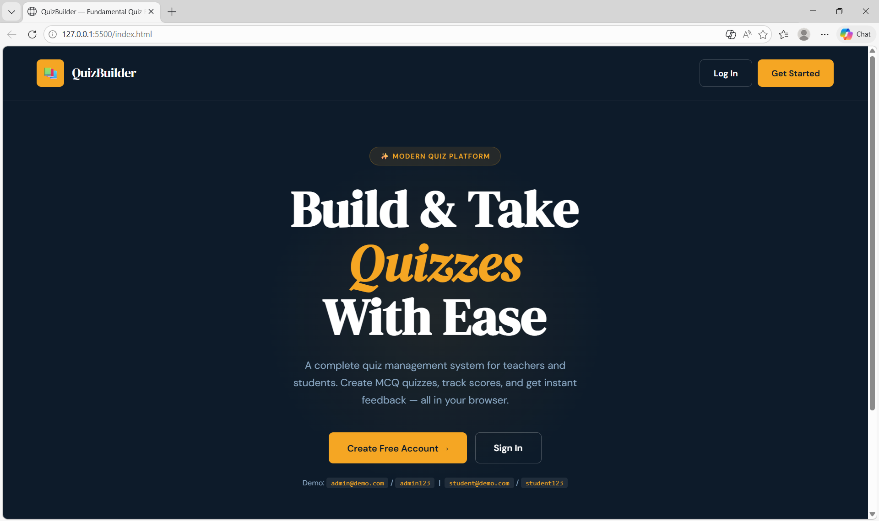
Screenshots for FWD & DSA

Slide 11
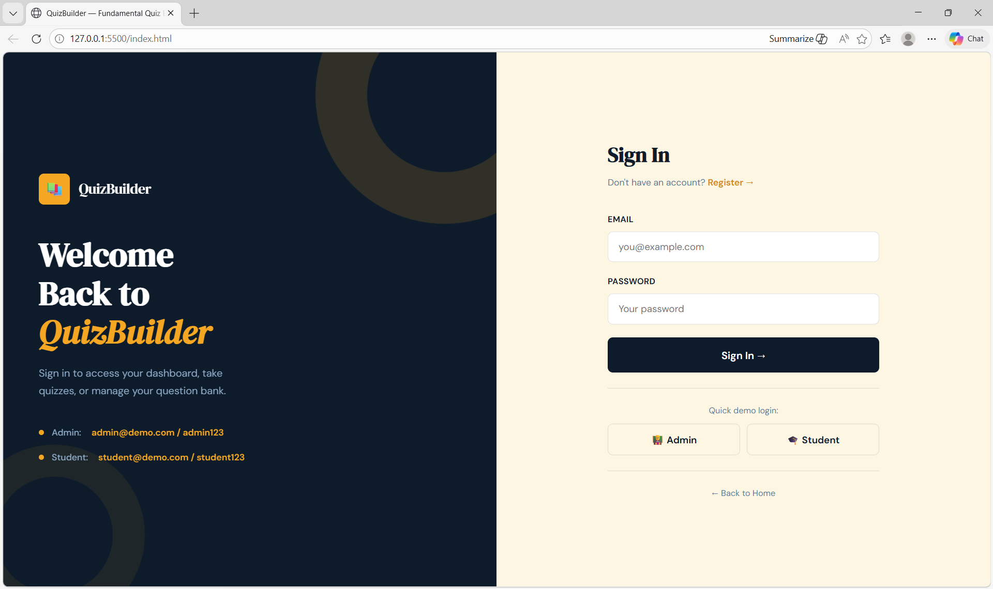

Slide 12
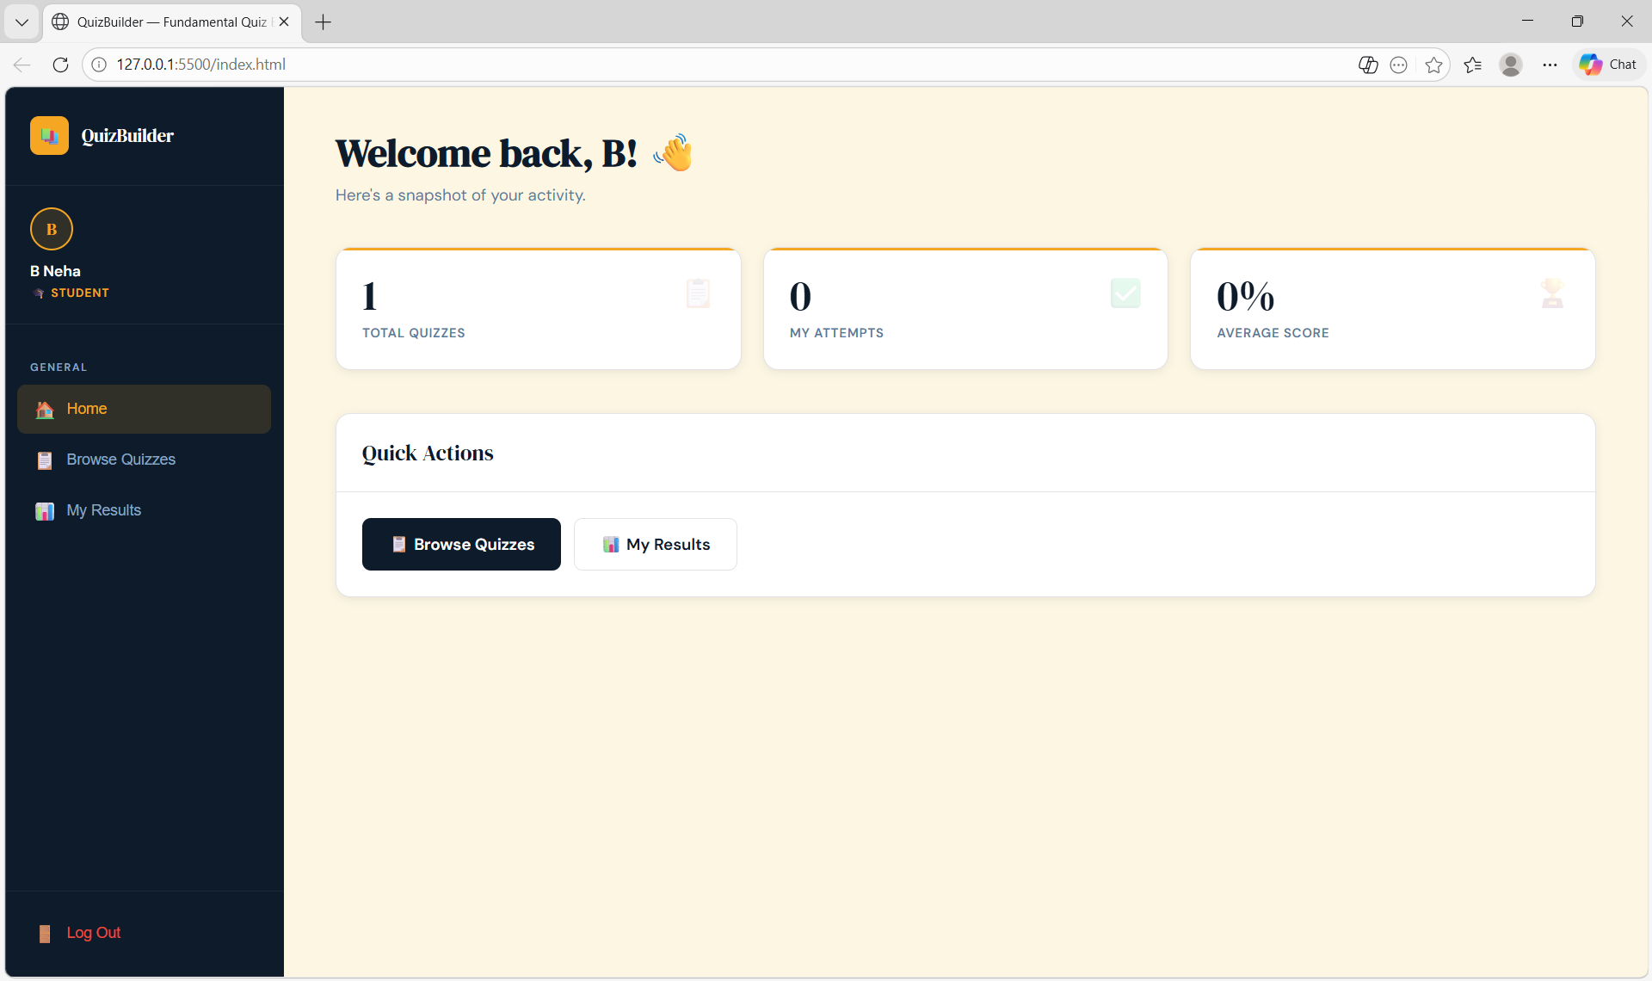

Slide 13
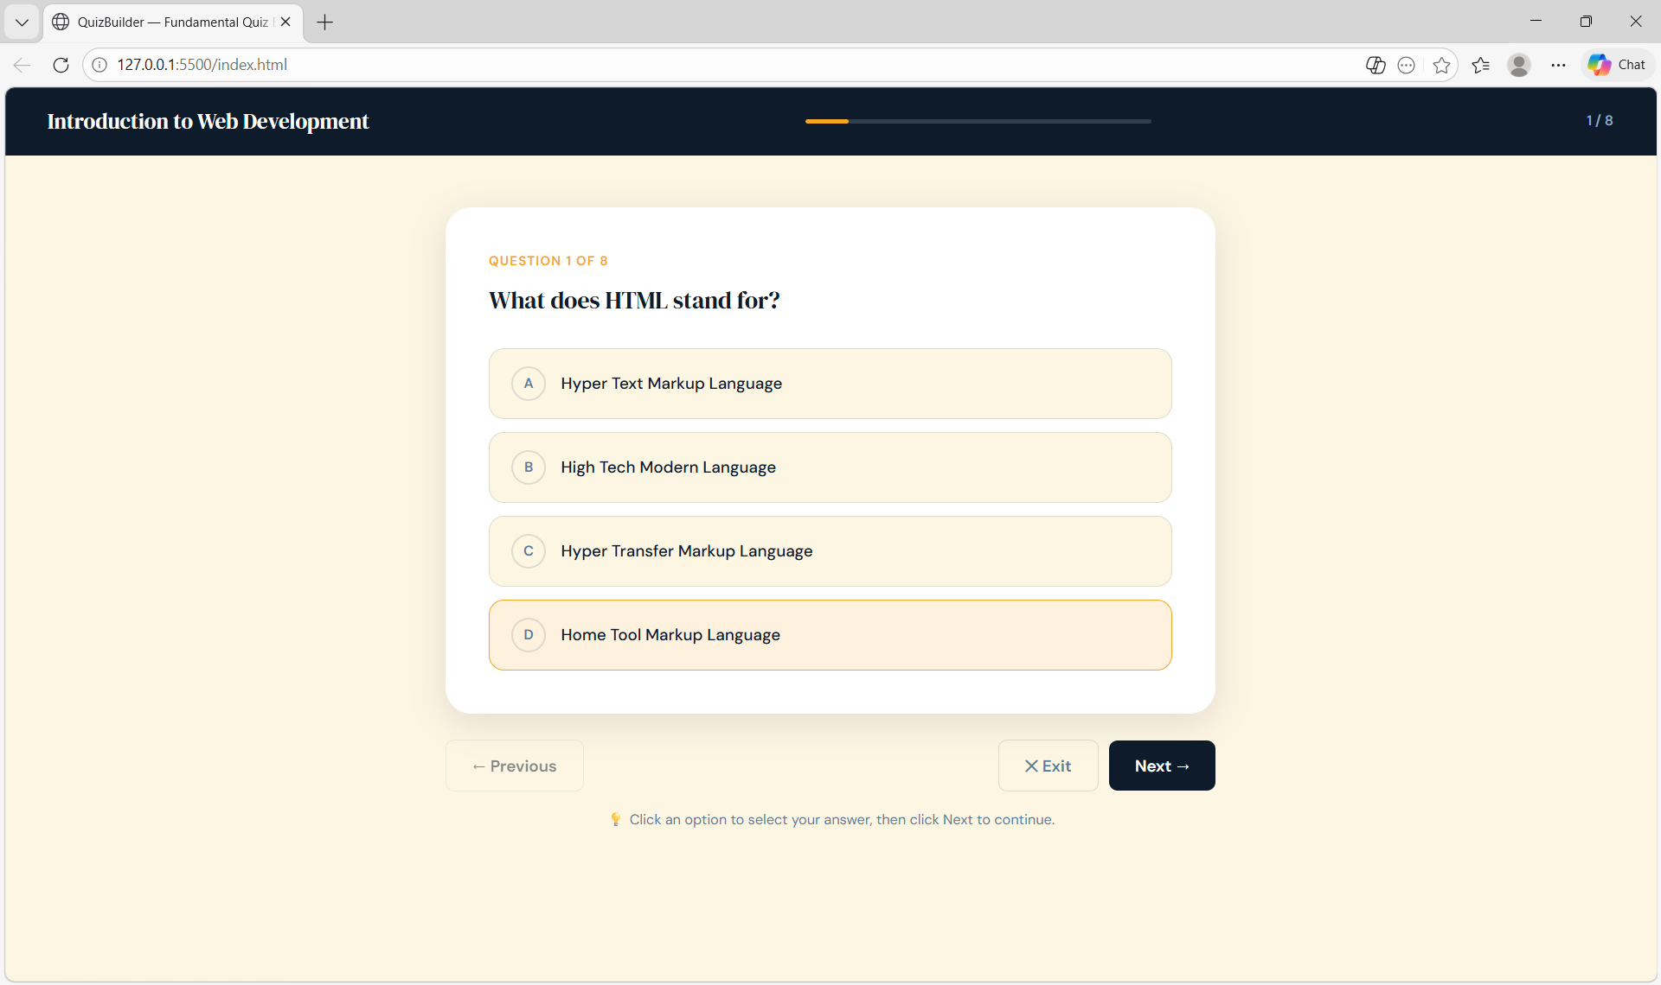

Slide 14
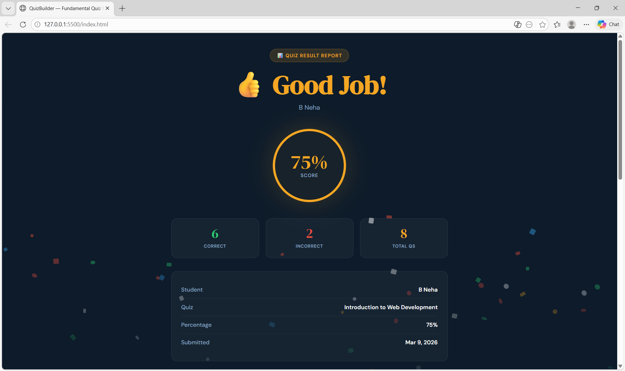

Slide 15
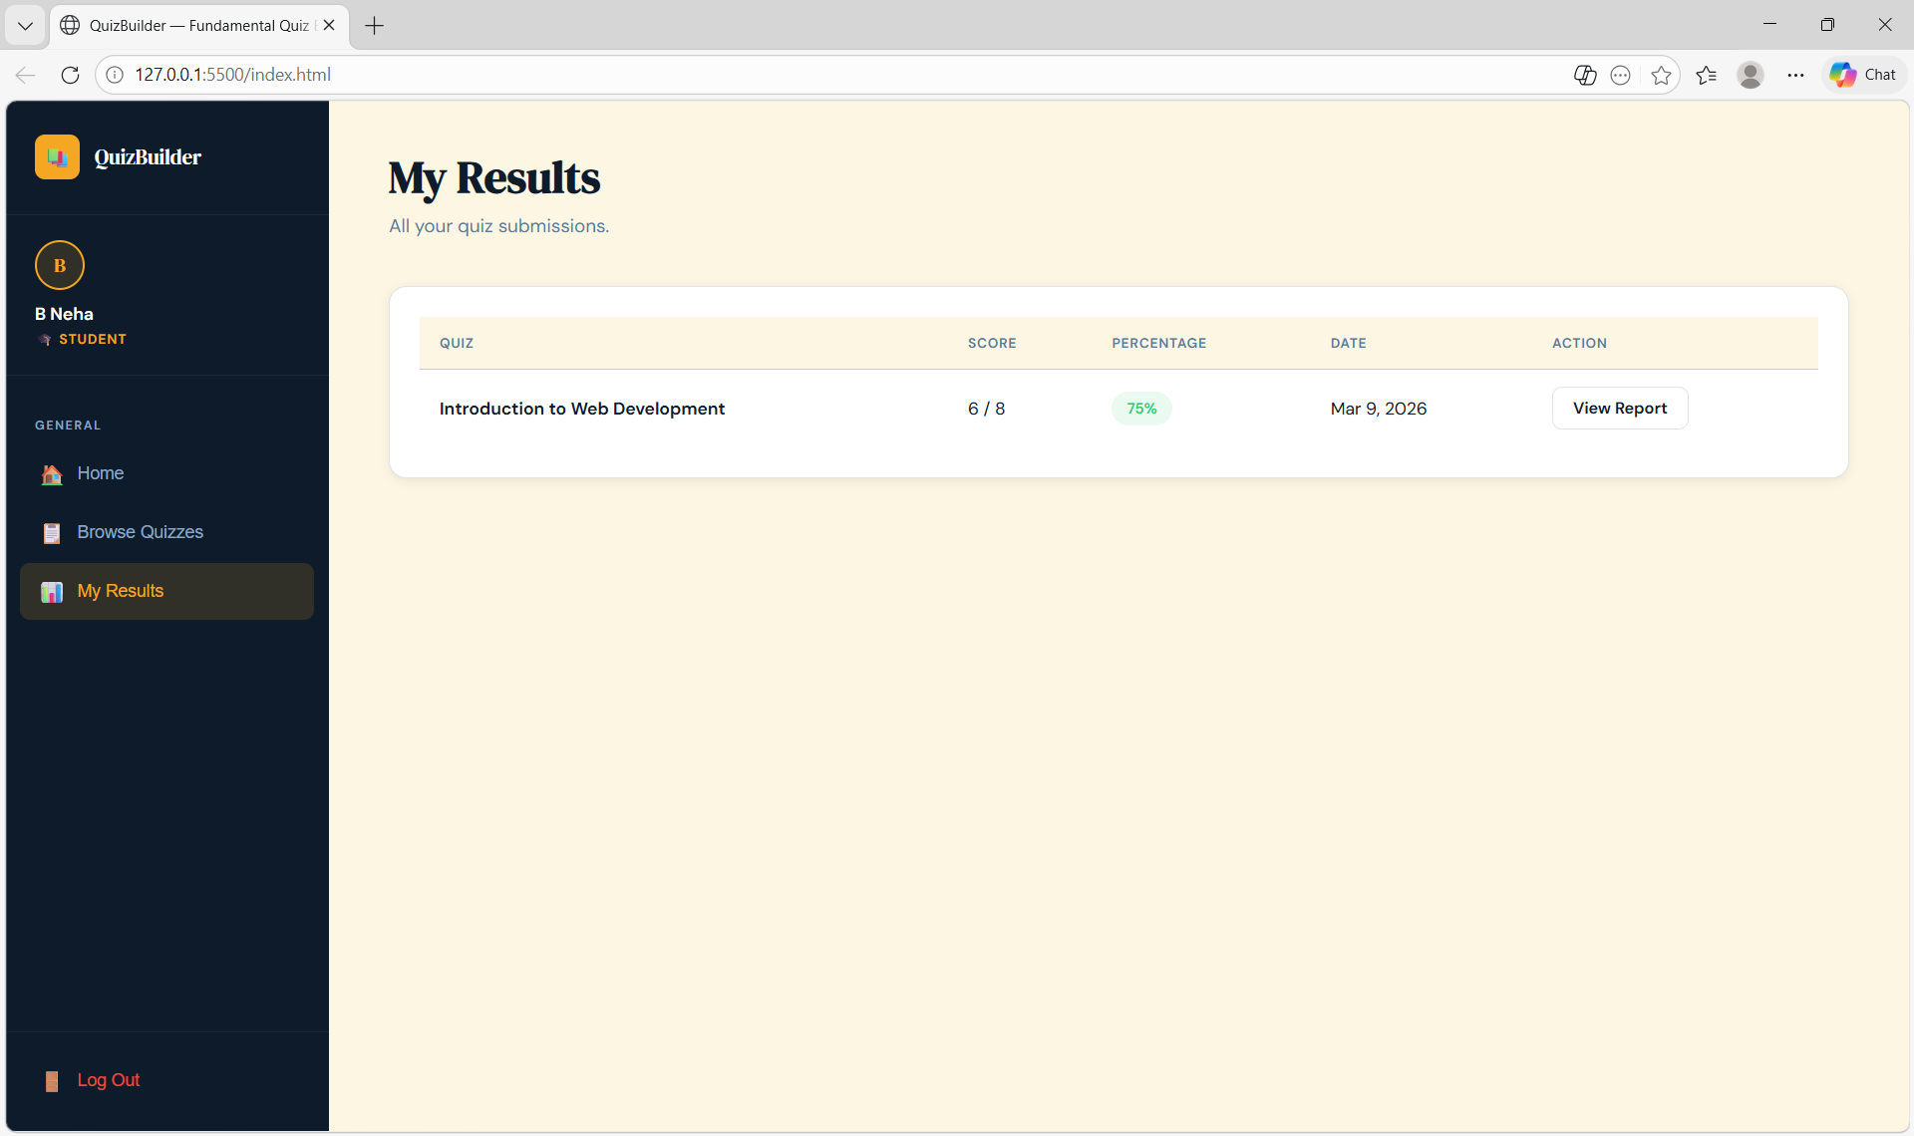

Slide 16
Conclusion
Fundamental Quiz Builder simplifies online assessments
Reduces manual evaluation effort
Provides quick feedback to learners
Easy to use and accessible web platform
Can be enhanced with database and analytics

Slide 17
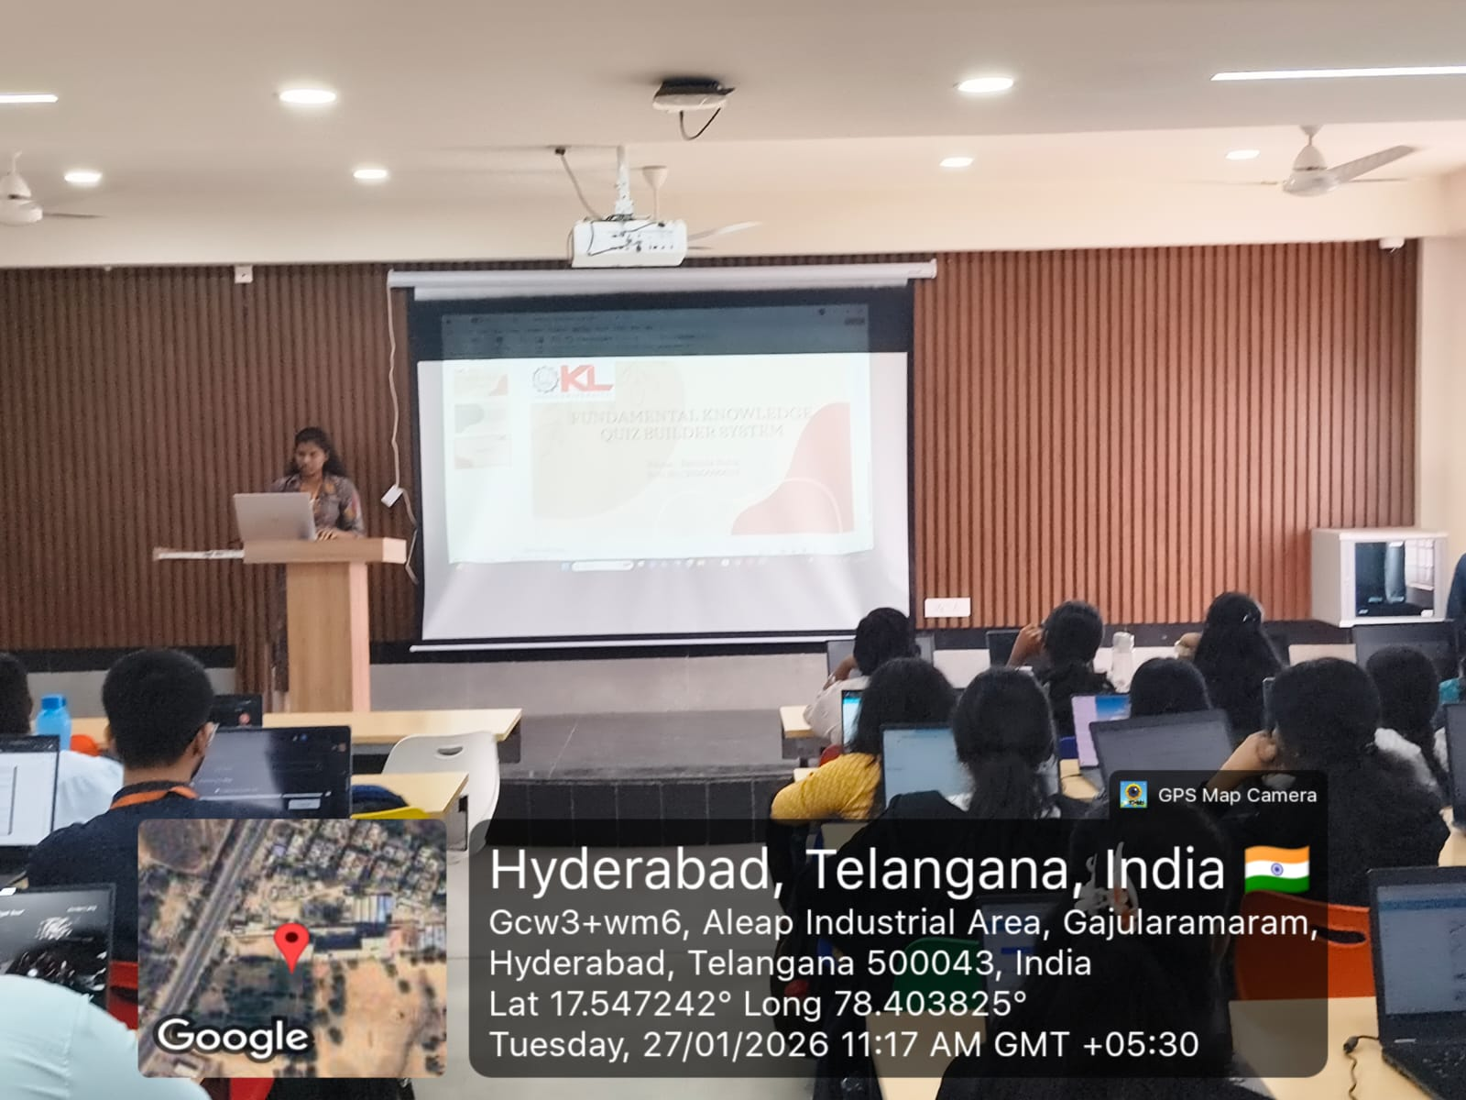
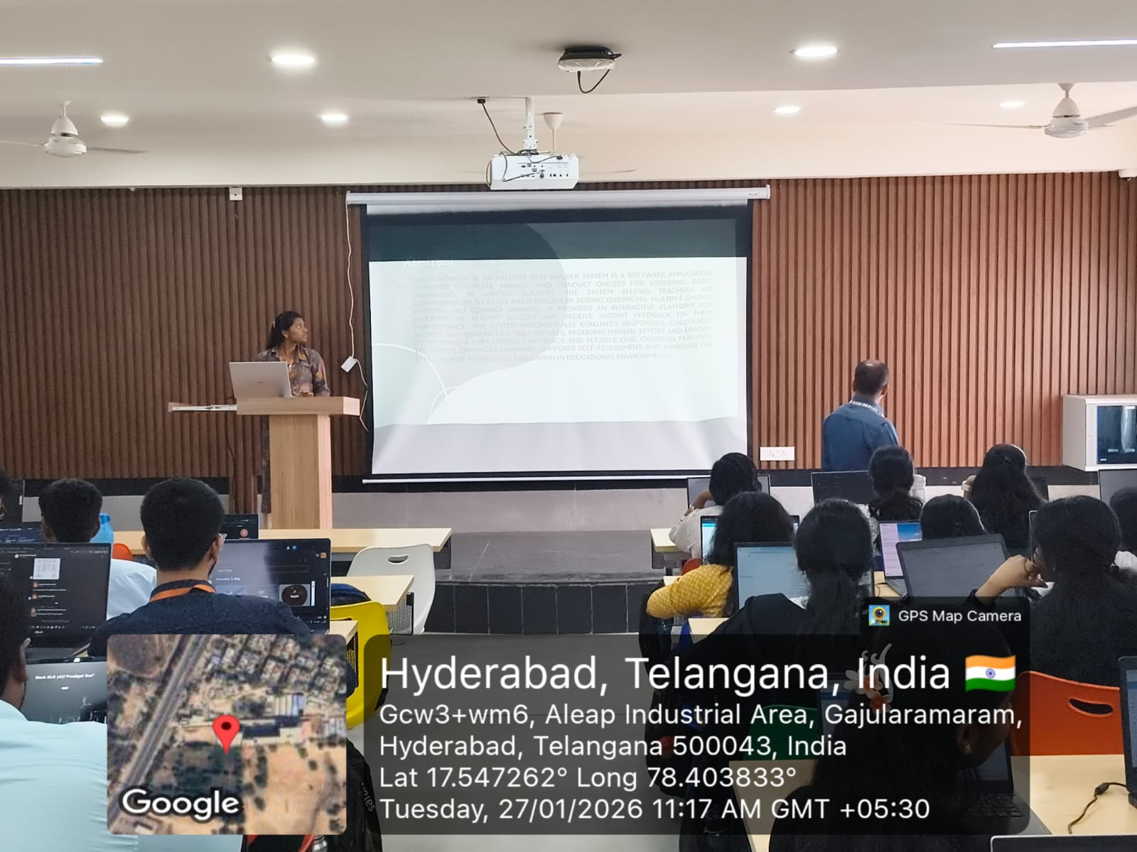
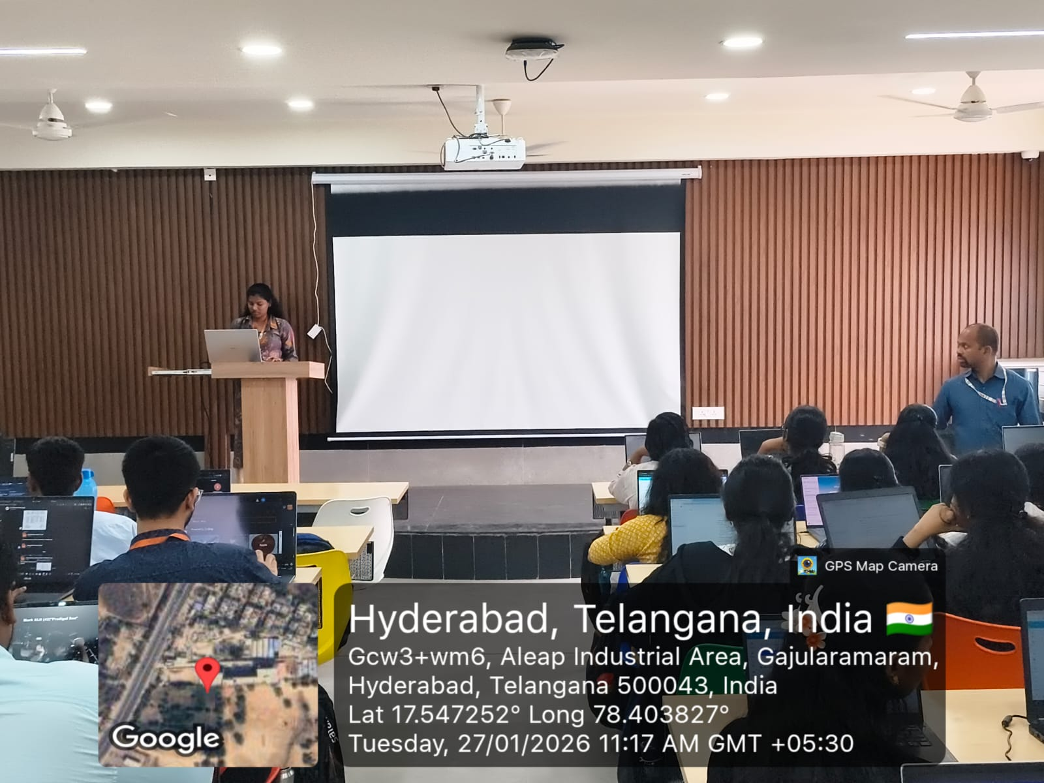
Geo- Tag Photos

Slide 18
THANK YOU

